Slide 1



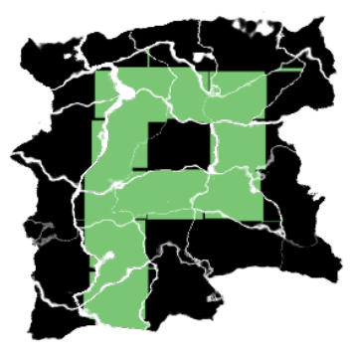




Globalization in
Free Software Communities
@JobavaL10n

Slide 2

What?
“It's about the cultural adaptation of software”
Jeff Beatty – Localization head at Mozilla
Notes:
We aren't talking about mere translation, but the cultural adaptation of software. This involves not just language, but also local customs and country. For example, Spanish is spoken in Latin America, but each country has a distinct dialect and even different styles of address and expression. For that reason, Firefox is localized not into Spanish, but Spain-Spanish, Argentinian, Chilean, Mexican etc.

Slide 3
What?
i18n, L10n, g11n
Notes:
Here I ask the audience if they know what the three terms displayed are.
I also ask the audience if they've been involved directly or indirectly in any stage of a globalization (internationalization, localization).

Slide 4
What?
i18n -> internationalization

Slide 5
What?
i18n -> internationalization
L10n -> localization

Slide 6
What?
i18n -> internationalization
L10n -> localization
i18n + L10n -> globalization

Slide 7
Why?
globally-relevant applications need to be in the user's language
small % of audience actually comfortable in English
largest growth markets not English-speaking
a chance to build a community around your project
it's easy! (but can be tricky)

Slide 8
Tools
Pootle (2004) –> django + redis + SQL
Mozilla Firefox, websites, Libreoffice
Includes translation memory
Older and more mature tool

Slide 9
Tools
Pontoon (2011) -> django + postgres + heroku
Websites, Mozilla Firefox (Slovenia)
Uses external TM Amagama
Notable feature: in-website localization

Slide 10
Before we dive in
Languages have different plural forms (cardinals)
English: 2 (singular, plural)
Romanian: 3 (singular, 2 plurals)
Japanese, Chinese: 1 form
Russian and most Slavic languages: 4 forms
Gaelic languages: 4 or 5 forms
Arabic: 6 forms

Slide 11
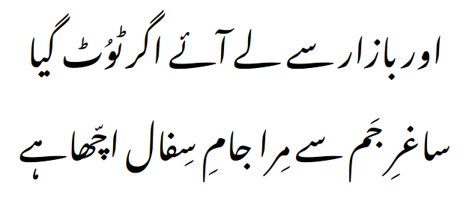
Wrong ASSUMPTIONS
“I can get another if I break it / so a clay cup trumps a grail”
(Mirza Ghalib)
Every language is written left-to-right
Notes:
Text in the image is from a poem by Urdu poet Mirza Ghalib. It means “I can get another if I break it / so a clay cup trumps a grail”

Slide 12
Wrong ASSUMPTIONS
; ⸮
“” „” « » 「 」
Every language has the same punctuation
Notes:
The sign on the top left is a Greek question mark
The sign on the right is not a question mark

Slide 13
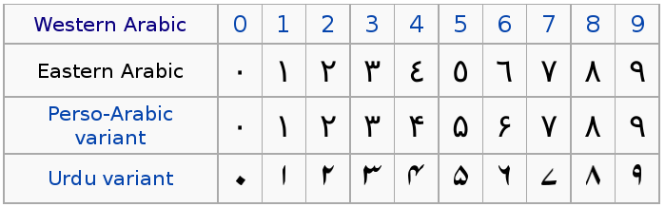
Wrong ASSUMPTIONS
Every language has the same numeric symbols
Notes:
Some cultures have traditional style numerals. Those depicted here are also practically applicable since they also follow the RTL text orientation of their language, so text containing traditional numerals will be consistent as far as orientation.

Slide 14
Start with
A flexible UX
make sure strings 2-3 times as long fit into the interface (many languages longer than English)
  Romanian: 20% on average longer
  Italian, Russian: 25%
  French: 32%
  Chinese, Japanese, Korean: -50%
Notes:
The average figures matter less than individual string variations which can be longer.

Slide 15
Continue with
A glossary of terms
app-specific terms
generic technical terms that need to stay consistent
trademarks and other proper names
Notes:
The app-specific terms and trademarks should involve the developer or product side people.

Slide 16
Know also
Localization is not translation
Clarity > strict accuracy
Space considerations
Idioms and pop culture don't translate well (bring me a shrubbery!)
Localization is adaptation and translation
Notes:
Clarity trumps strict translation accuracy. The purpose is not to have a good translation, but to have an interface that conveys the meaning and intent the developers had in mind. In that respect, sometimes we use English variants of technical terms when the audience understand what we mean. Sometimes the translation of a word from English produces a result that's homonymic and thus ambiguous (for example: the English words „core” and „kernel” both translate to the same Romanian word: „nucleu”).

Slide 17
How?
Typical workflow:
Mark strings in source code i18n
Extract strings into a localization format i18n
Manage extracted strings (pref w/ a tool) L10n
Translate the strings (pref w/ GUI tool) L10n
Insert strings back into the application L10n
Notes:
This describes the workflow from i18n to g11n.

Slide 18
The g11n process
1. Mark strings in source code (gettext example)
printf("Hello World\n");
window.set-title("Teh Awesome");
↓
printf(gettext("Hello World\n"));
window.set-title(gettext("Teh Awesome"));

Slide 19
The g11n process
2. Extract strings into a localization format
#comment to string 1
msgid "Hello World\n"
msgstr ""
#comment to string 2
msgid "Teh Awesome"
msgstr ""

Slide 20
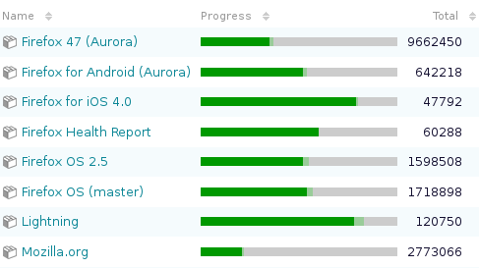
The g11n process
3. Manage extracted strings

Slide 21
The g11n process
4. Localize (translate, adapt)
watch for: string length, consistency
each language should have style guide
msgid "Hello World\n"
msgstr "Witaj świecie\n"
Notes:
The style guide is the localizer's job if one doesn't exist already. You can usually just build on top of the work done by similar projects out there, or software for that particular language.

Slide 22
What localizers need
Terminology control (app-specific or like L10n.ro/Glosar)
Good search functionality
Translation memories (app-specific or like Transvision)
Machine translation (eg. Google or Bing translate)
General purpose dictionaries (eg. hallo.ro)
Good UX, low technical barriers
Notes:
I skip this slide if time is short so I can allocate time for live translation.

Slide 23
Make it easier on them
Context matters
  use whole sentences
  group strings together semantically
Idioms and pop-culture translate badly
  don't be too punny
Give credit
Swag – stickers, t-shirts, pins, posters etc.
Notes:
I skip this slide if time is short so I can allocate time for live translation.

Slide 24
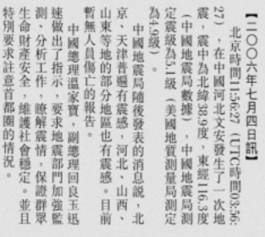
Potential gotchas
RTL
  right-to-left layouts and bi-di text
Top-to-bottom
  Chinese, Japanese
Notes:
I skip this slide if time is short so I can allocate time for live translation.

Slide 25
Pitch
To project leaders, decision makers and programmers
Opportunity to create a community
Application needs to be globally relevant
  highest-growth markets are non-English
More testers
More users
Notes:
I skip this slide if time is short so I can allocate time for live translation.

Slide 26
Pitch
To students and applicants
Gain experience volunteering and working for open-source projects
Few or no technical skills needed
Be near technically excellent people
Notes:
I skip this slide if time is short so I can allocate time for live translation.

Slide 27
Pitch
To free software and people in general
Grow the ecosystem
Contribute and get in touch with great communities
Promote and impact your local language and culture
Scratch an itch
Notes:
I skip this slide if time is short so I can allocate time for live translation.

Slide 28
Conclusions
Not daunting if you know where to begin
Can be tricky depends on language and f/w
Can be messy working with people
Fun

Slide 29
Live Translation
FIREFOX
Libre Office
mozilla.org
GNOME
Notes:
I like to dedicate at least 10 minutes on this stage, so will compress the presentation to fit this in.
It's important to have audience participation and coax a few of them to actually contribute a few translations.
It's even better if there are non-English, non-Romanian speakers in the audience, who can then contribute a suggestion to a different locale.

Slide 30

Questions?
Twitter: @JobavaL10n
Blog: medium.com/@Jobava/latest
Email: jobava@mozilla.ro

